Slide 1
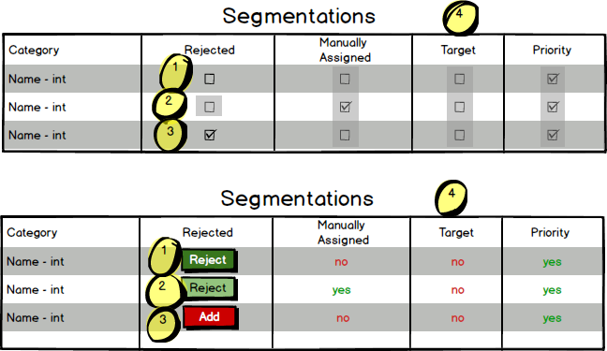
Option One:
Pros:
Extends the existing convention.
Rapid to develop.
Cons:
Feedback relies on modal messages (failure, error).
Initial Training effort
Option Two:
Pros:
New convention.
More time to develop.
Possible confusion with manual assignment content.
Cons:
Breaks existing convention.
Training effort.
Failure & Error state still reliant on modals.
Actionable item in positive state
Item non actionable due to dependent state (manually added coverage cannot be rejected after)
Actionable Item in negative state
Derived Properties non-actionable from this interface

Slide 2
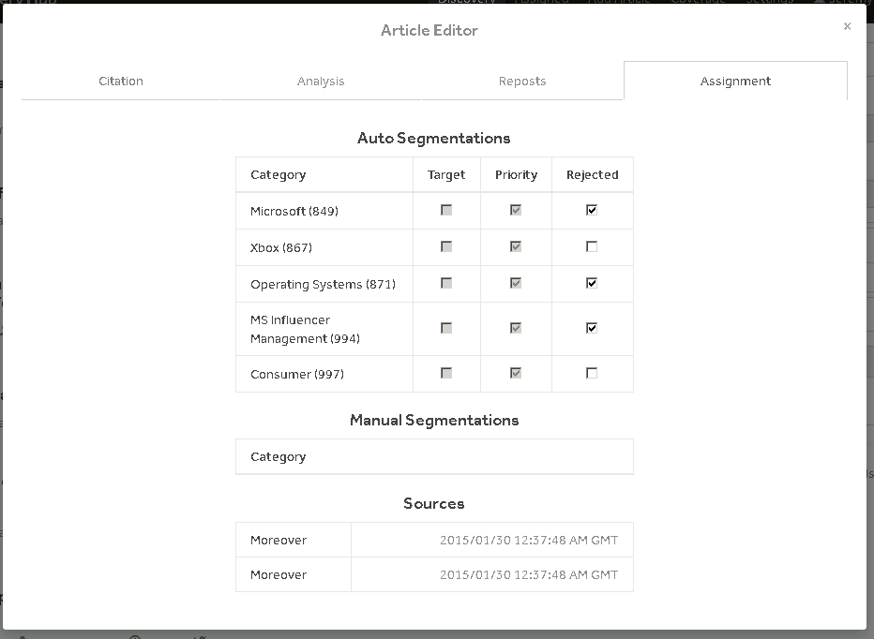
“Checks”
Pros:
Consistent.
Rapid to develop.
Cons:
Difficult to parse quickly.
Requires recall over recognition. Actionable vs non actionable.
meaning of state.
Feedback relies on modal messages (failure, error).

Slide 3
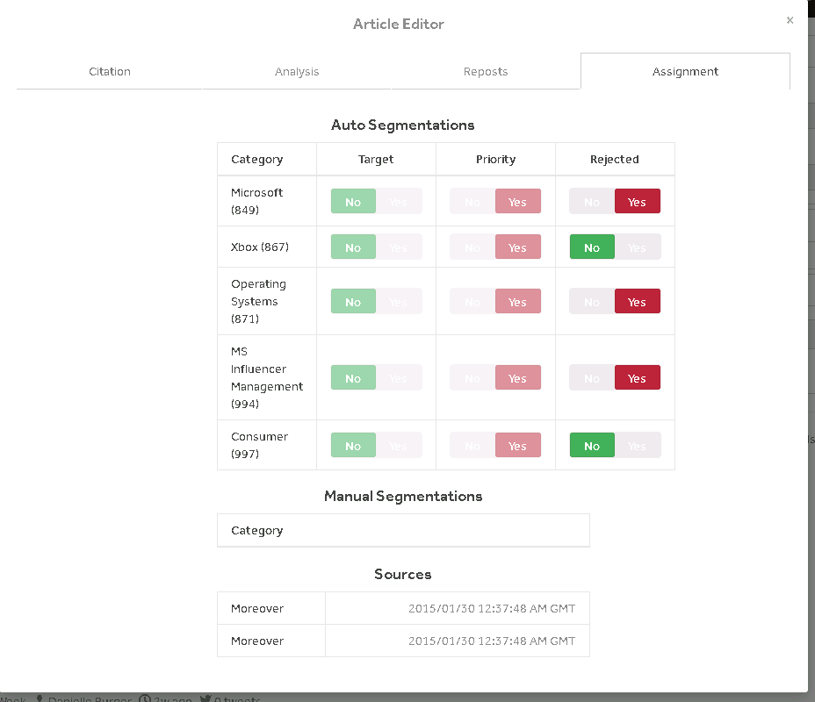
“Switches”
Pros:
Consistent.
Rapid to develop.
Cons:
Easily parsed (color and text)
Requires recall over recognition. Actionable vs non actionable.
meaning of state.

Slide 4
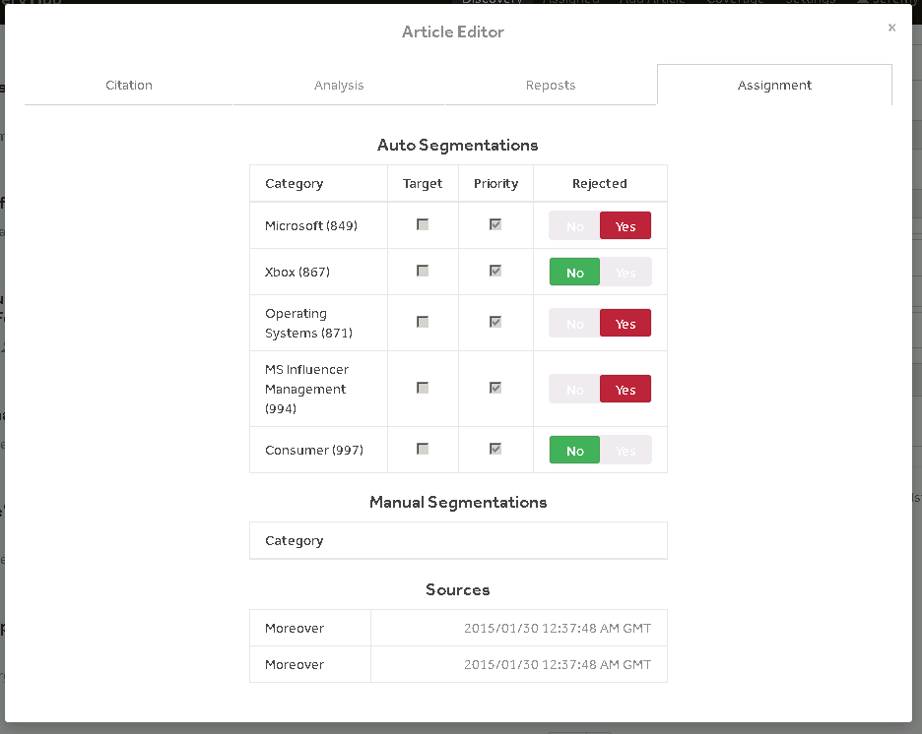
“Split”
Pros:
Visibility of data.
Rapid to develop.
Matches user language
Difference between actionable and informational.
Cons:
Easily parsed (color and text)

